Slide 1
Unit 6-2 Tests for Parallelograms
PLANE Geometry

Slide 2
Five Ways to Prove a Quadrilateral is a Parallelogram:
Both Pairs of Opposite Sides are Parallel.
Definition of a Parallelogram
$$A$$
$$B$$
$$D$$
$$C$$

Slide 3
Five Ways to Prove a Quadrilateral is a Parallelogram:
If Both Pairs of Opposite Sides of a Quadrilateral are Congruent, then the Quadrilateral is a Parallelogram.
$$A$$
$$B$$
$$D$$
$$C$$

Slide 4
Five Ways to Prove a Quadrilateral is a Parallelogram:
If Both Pairs of Opposite Angles of a Quadrilateral are Congruent, then the Quadrilateral is a Parallelogram.
$$A$$
$$B$$
$$D$$
$$C$$

Slide 5
Five Ways to Prove a Quadrilateral is a Parallelogram:
If the Diagonals of a Quadrilateral Bisect Each Other, then the Quadrilateral is a Parallelogram.
$$A$$
$$B$$
$$E$$
$$D$$
$$C$$

Slide 6
Five Ways to Prove a Quadrilateral is a Parallelogram:
If One Pair of Opposite Sides is Both Congruent and Parallel, then the Quadrilateral is a Parallelogram.
$$A$$
$$B$$
$$D$$
$$C$$

Slide 7
Five Ways to Prove a Quadrilateral is a Parallelogram
Both Pairs of Opposite Sides are Parallel (Definition of a Parallelogram)
Diagonals Bisect Each Other
One Pair of Opposite Sides are Both Congruent and Parallel
Both Pairs of Opposite Sides are Congruent
Both Pairs of Opposite Angles are Congruent

Slide 8
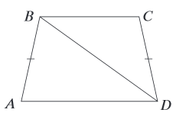
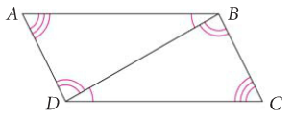
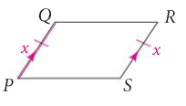
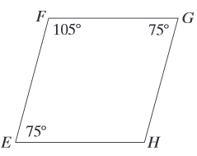
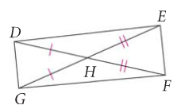
Notes:
1. No, 2. Yes, 3. No

Slide 9
Example 1:
Find the value of x. Then tell whether the figure must be a parallelogram.
$$A$$
$$5x+4$$
$$B$$
$$5x−3$$
$$3x+5$$
$$D$$
$$C$$
$$7x−4$$

Slide 10
Example 2:
Find the value of x. Then tell whether the figure must be a parallelogram.
$$A$$
$$B$$
$$2x+40$$
$$2x−30$$
$$x+20$$
$$3x$$
$$C$$
$$D$$

